Slide 1

WAY TO ENTERPRISE
Pakage 1: Database

Slide 2
WAY TO ENTERPRISE
Lesson 3

Slide 3
Agenda
Query Data Statement
Modify Data Statement
Assignments
Copyright © VTI Academy All Rights Reserved

Slide 4
QUERY DATA STATEMENT
(8) SELECT column_name_1, column_name_2, …
(1) FROM table_name
(2) [JOIN]
(3) [WHERE]
(4) [GROUP BY]
(5) [HAVING]
(6) [ORDER BY]
(7) [LIMIT]

Slide 5
SELECT BASIC
Select fields in the table
    SELECT *
    FROM table_name;
View only some of the listed fields
    SELECT column_name_1, column_name_2
    FROM table_name;

Slide 6
WHERE - Operator
AND / OR
BETWEEN…AND
IN / NOT IN
LIKE / NOT LIKE (wildcard: % _)
IS NULL / IS NOT NULL
= , >, <, >=, <=, !=, <>

Slide 7
WHERE - EX
SELECT firstName
FROM Employees
WHERE firstName LIKE ‘D%’ , ‘%U%’ , ‘%Y’;

Slide 8
Distinct
Eliminate duplicate values in column
    SELECT DISTINCT column_name
ORDER BY
    ORDER BY column_name_1, column_name_2 ASC/DESC
    Note: Default = ASC

Slide 9
Aggregate functions
Includes:
    COUNT()
      COUNT(field_name), COUNT(DISTINCT field_name), COUNT(*), COUNT(1)
    SUM(),
    MIN(),
    MAX(),
    AVG()
Note: Applies only to # null values

Slide 10
GROUP BY/ HAVING
To group values together (group) then perform calculations with Aggregate Functions (count, sum, min, max, avg)
Group by can apply to multiple columns
If you want to have conditions in ‘Group by’ then use HAVING

Slide 11
LIMIT
Limit the number of records that return results

Slide 12
Alias
Use to rename the field or table

Slide 13
MODIFY DATA STATEMENT
Insert Statement
Update Statement
Delete Statement

Slide 14
INSERT STATEMENT
Method 1: Insert each record
    INSERT INTO table_name (column1, column2, column3, ...)
    VALUES (value1, value2, value3, ...);
Method 2: Insert multiple records at once (recommended)
    INSERT INTO table_name (column1, column2, column3, ...)
    VALUES (value1.1, value1.2, value1.3, ...),
    (value2.1, value2.2, value2.3, ...),
    (value3.1, value3.2, value3.3, ...);

Slide 15
UPDATE STATEMENT
Syntax:
    UPDATE table_name
    SET column_name_1 = value_1,
    column_name_2 = value_2,
    ...
    WHERE condition;

Slide 16
DELETE STATEMENT
Syntax:
    DELETE
    FROM table_name
    WHERE condition;

Slide 17
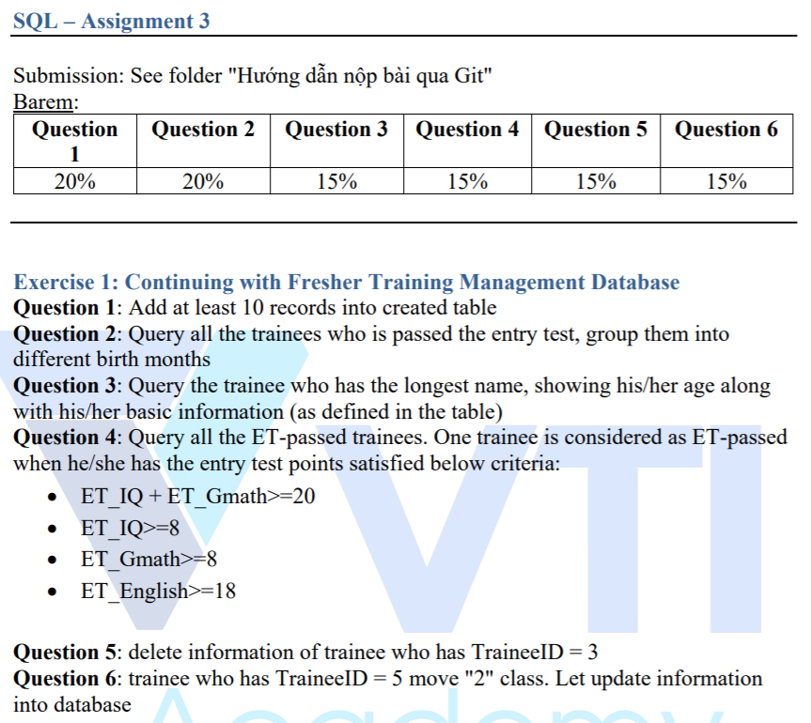
Assignments 1

Slide 18
Assignments 2
Assignment 2 for Testing System

Slide 19
Q & A
Copyright © VTI Academy All Rights Reserved

